Slide 1

Spring 2024
Engineering Entrepreneurship 325

Slide 2





Meet The Team
Aditya Medhi
Master of Science in Mechanical Engineering
Hetvi Rajani
Master of Science in
Biotechnology
Nico Garcia-Ippolito
Bachelor of Science in
Industrial Engineering
Nikhila Yeturi
Master of Science in
Information Technology
Yasemin Tekin
Master of Science in
Biotechnology

Slide 3
Our Mission
To offer efficient and cost-effective solutions for removing fats, oils, and grease from wastewater, promoting a cleaner global ecosystem.

Slide 4
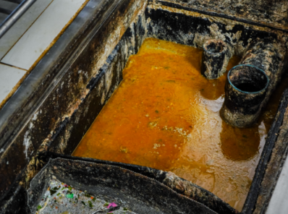

What’s Going On?
According to Environmental Protection Agency, FOG is responsible for 47% of blockages in the sewer system.
Local governments spend $25 billion a year to remediate grease-related issues — such as blockages, backups and overflows — to keep the sewers flowing.
Notes:
Talk about wastewater and the need for pretreatment from an environmental standpoint

Slide 5
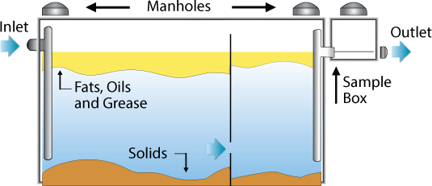
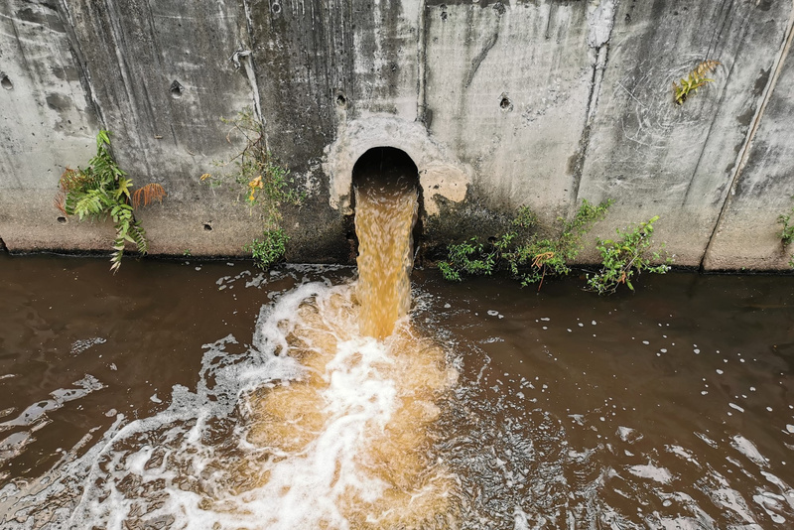
What’s Going On?
Industries and snack-food manufacturers often produce a significant amount of FOG
Disposal Challenges
Sewer blockages
Trouble in collection pipes
Strict regulations and steep penalties

Slide 6
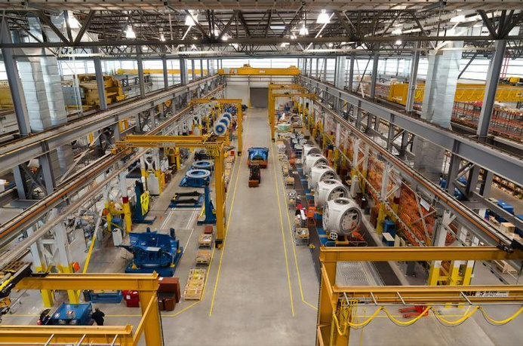


PAINS
Small facility for FOG treatment
Lack of Time
and Manpower
Crunched for dollars
Notes:
- Industries have small facilities or the current methods are inefficient
- crunched for dollars for investing in the capital hence prefer paying fines.
- $750 per violation

Slide 7



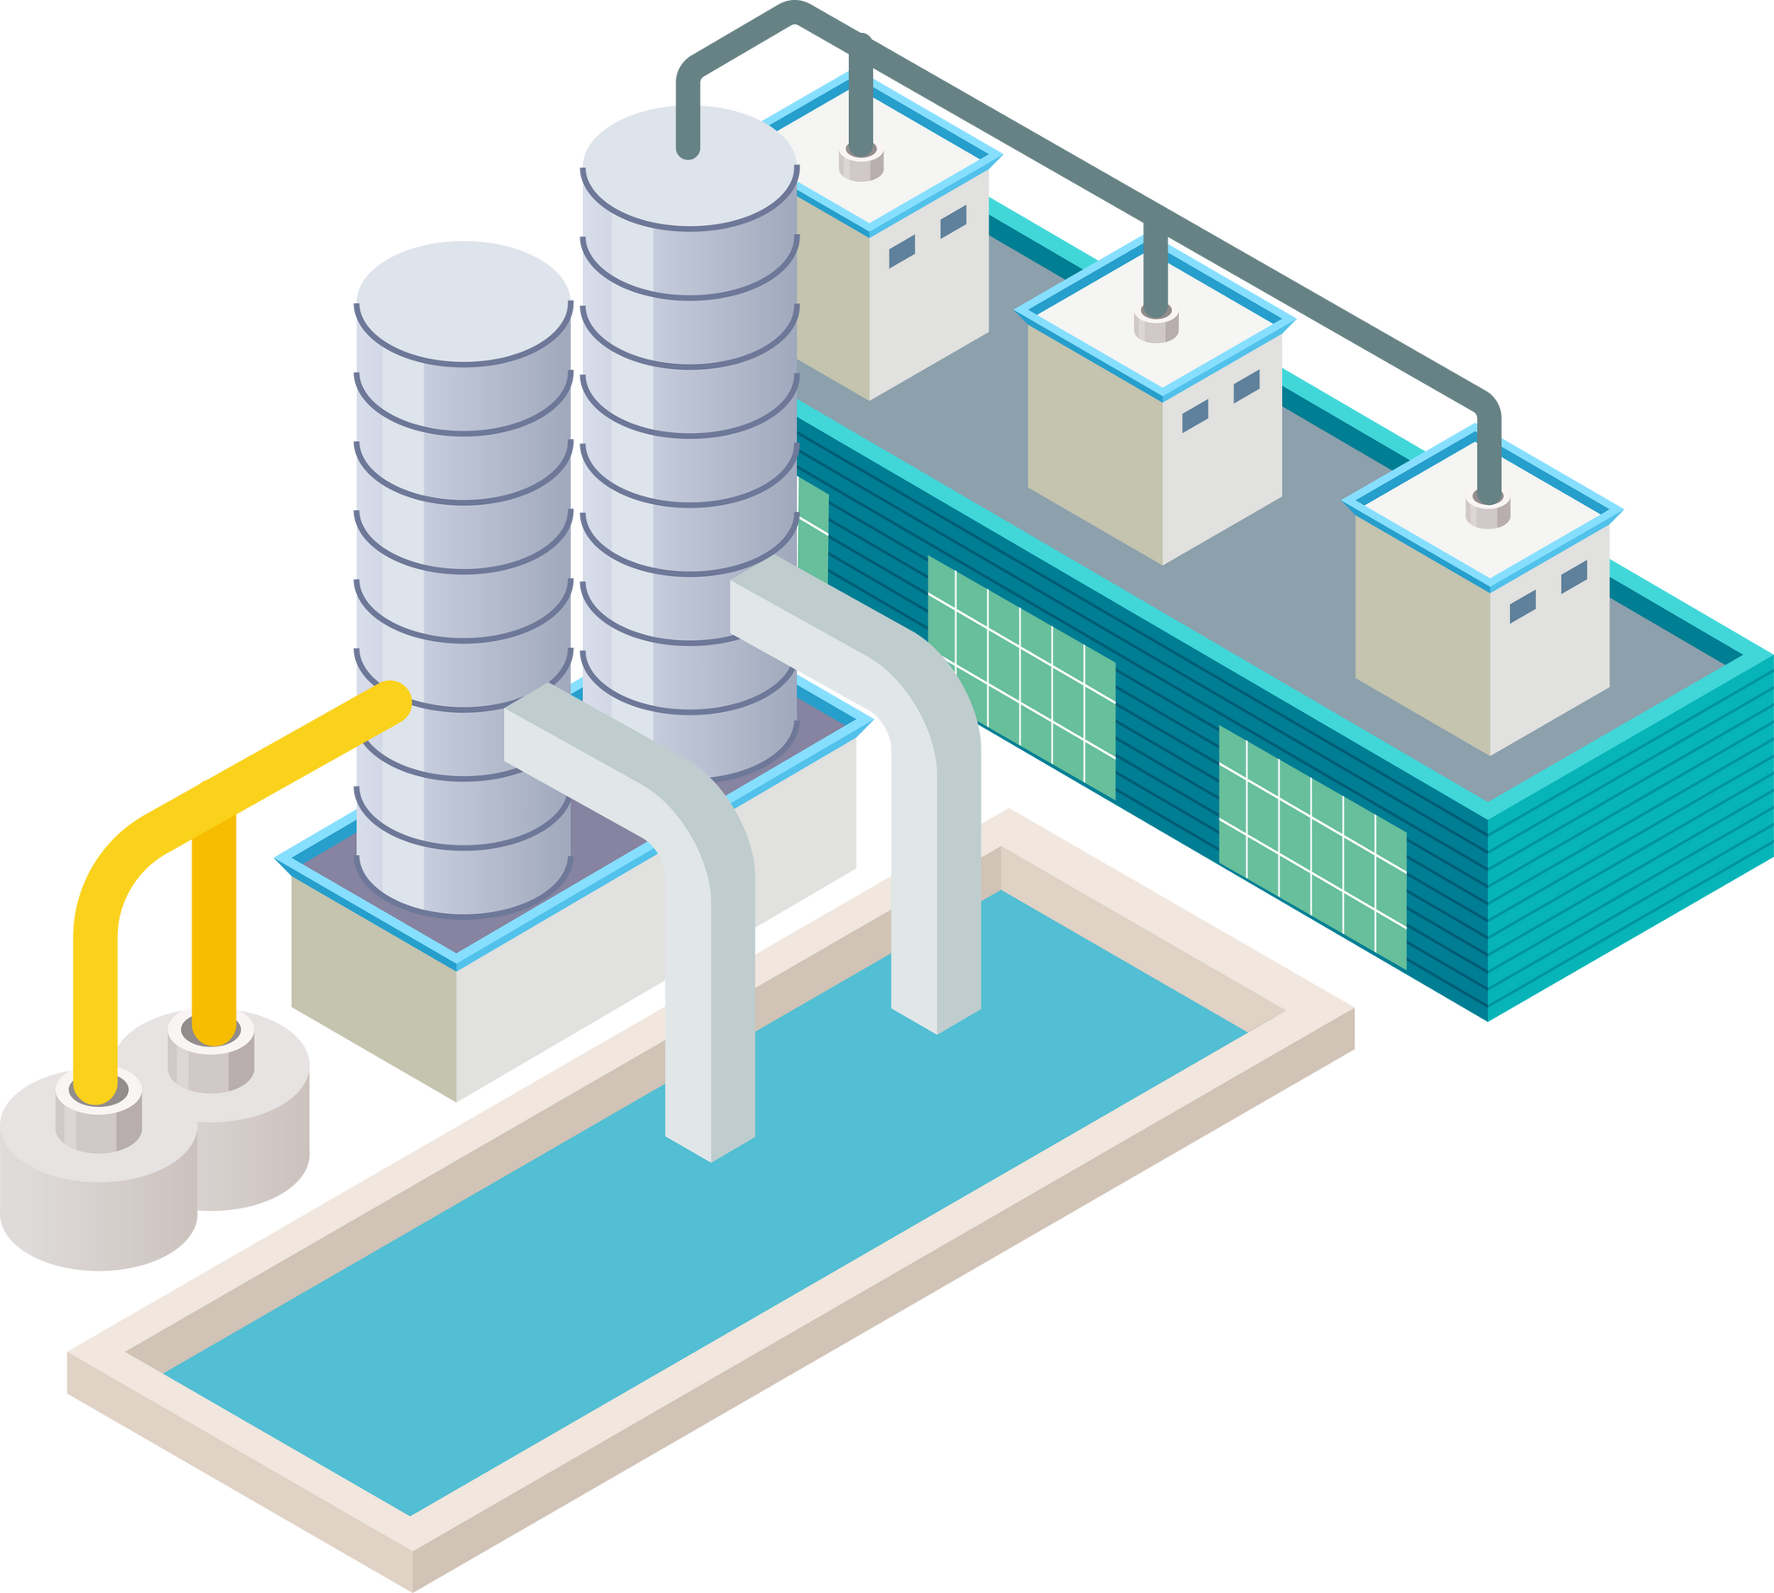





Industrial Wastewater Pre-Treatment
Industrial Wastewater
Regulatory Compliant Wastewater
Primary Treatment
Secondary Treatment
Tertiary Treatment
Employs screens and sedimentation
Employs biological treatment
Employs advanced filtration methods
Targets removal of remaining contaminants
Eliminates residual contaminants
Reduces solid content
Prepares for further treatment
Often requires additional treatment
Ensures regulation compliance
Notes:
Source: https://theaustin.com/blogs/the-role-of-water-in-food-processing/#:~:text=Secondary%20Treatment%3A%20Secondary%20treatment%20involves,into%20a%20surface%20water%20system.

Slide 8
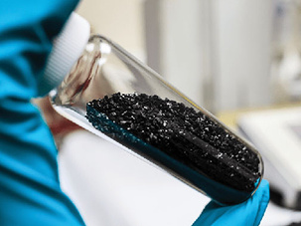
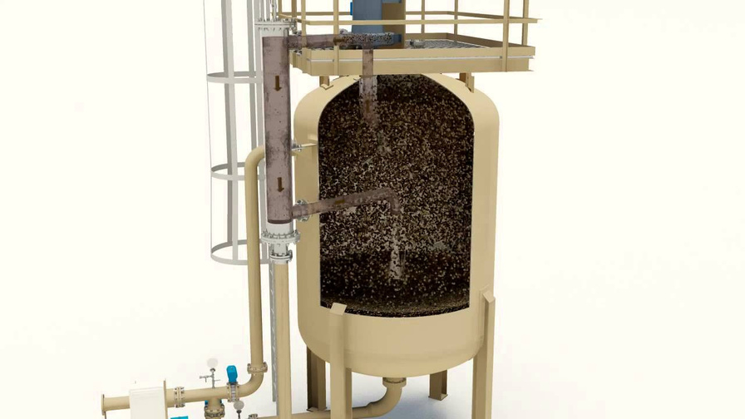

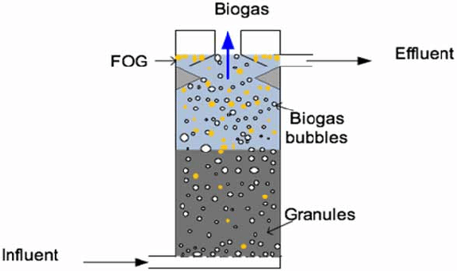
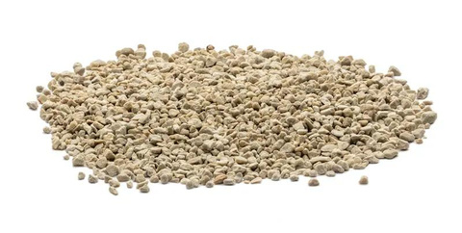
Treating FOG in Wastewater
Grease Traps
Up-flow Anaerobic Reactor
Adsorbents
Primary Treatment
Secondary Treatment
Tertiary Treatment
Removing the FOG layer is costly and extremely laborius!!!
Notes:
Source: https://theaustin.com/blogs/the-role-of-water-in-food-processing/#:~:text=Secondary%20Treatment%3A%20Secondary%20treatment%20involves,into%20a%20surface%20water%20system.

Slide 9

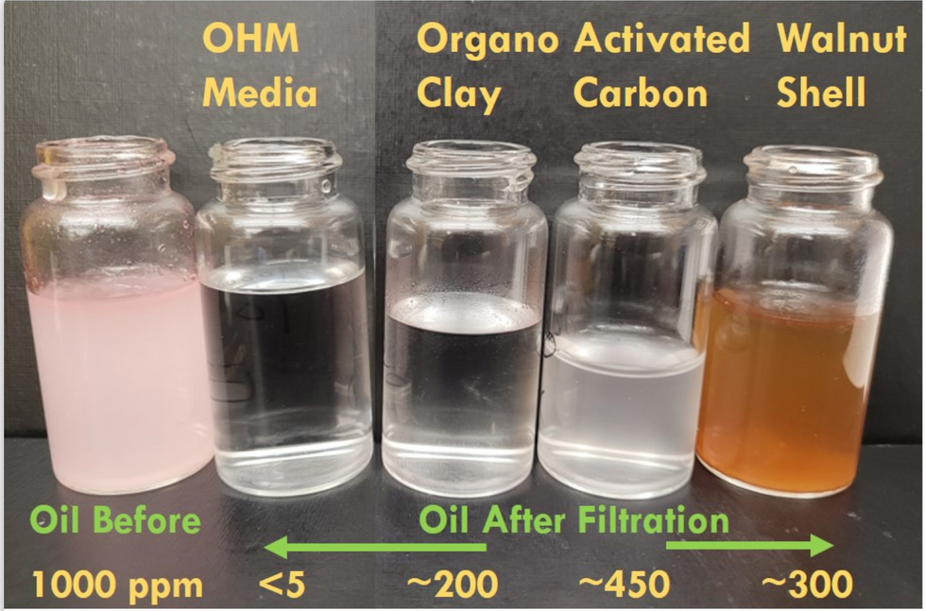



Solution: OHM Media™
Our OHM Media™ excels in attracting oil and repelling water, offering a versatile solution for separating oil from water.
Oil Absorbance Capacity
Cost-effective
Absorption Compared Across Methods
Generates less inventory via reusability & efficiency
Achieves a 90-99% absorption rate for trace oil
Reusable
Retains selectivity across multiple uses
Operates effectively even in harsh conditions
Simply press out the oil
Notes:
Specialized filtration membrane developed by MFNS Tech to efficiently treat wastewater with low oil content.

Slide 10
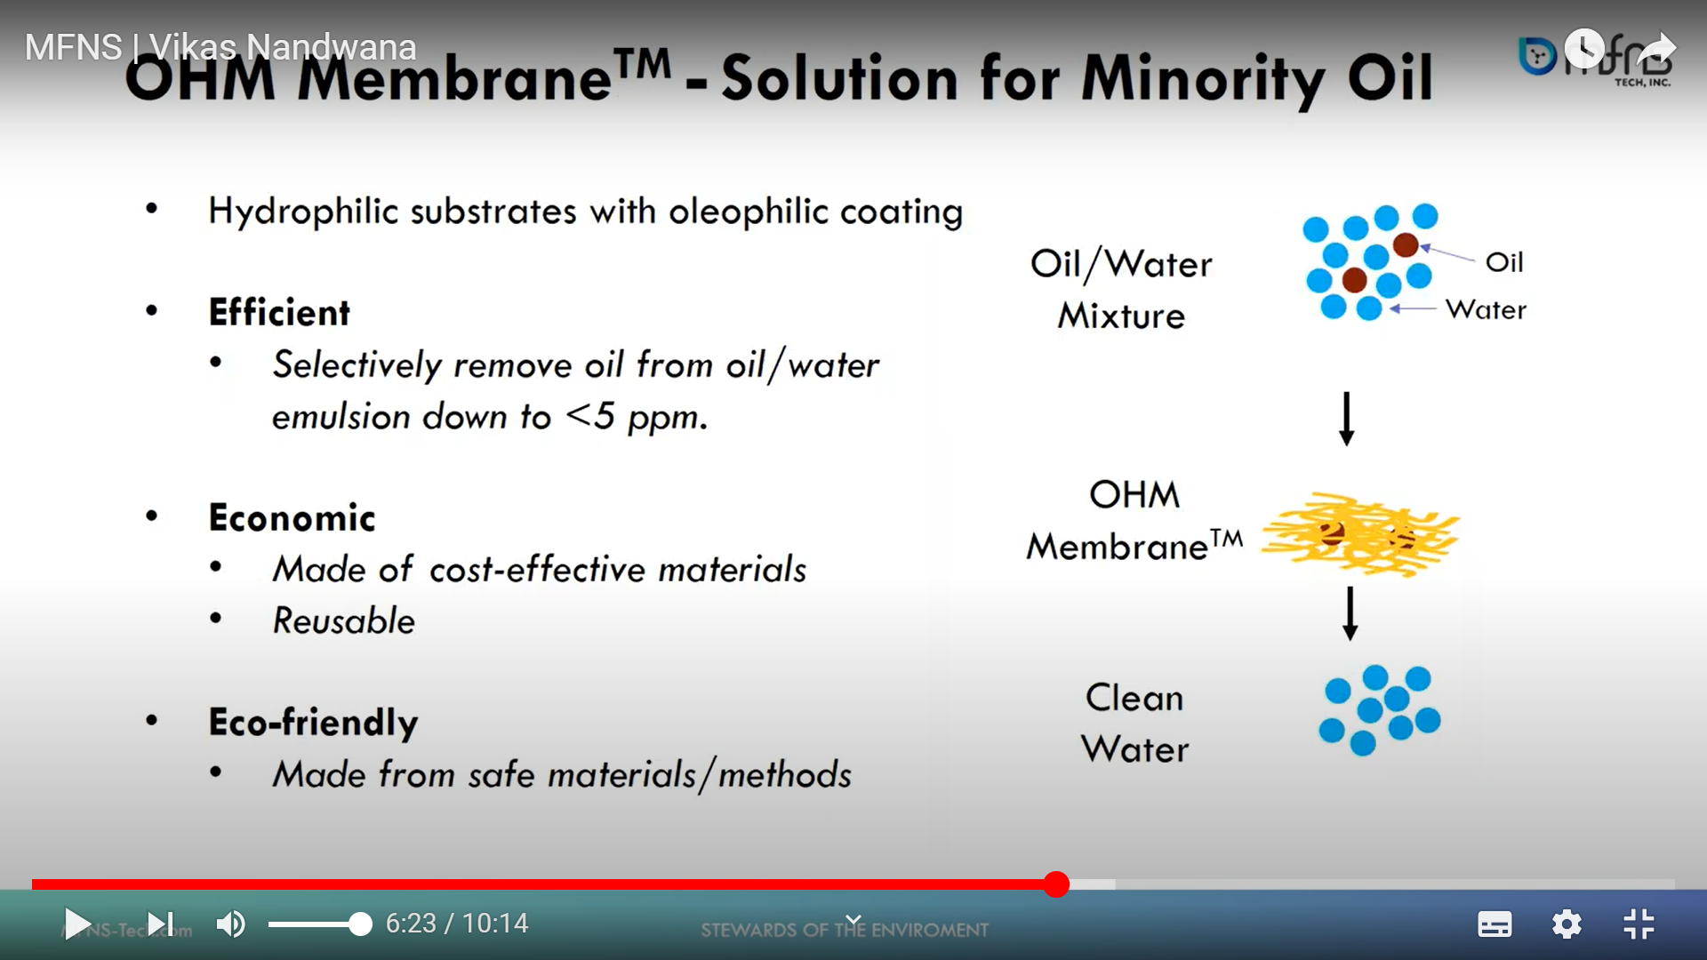
Understanding OHM Media
OHM Media Composition:
How does OHM Media Work?
Nanocomposite slurry made of graphite and magnetic nanostructures (MNS)
Shredded sponge substrates
OHM media coated sponge serves as efficient filter media for tertiary treatment of oil in wastewater
Platform Technology Integration
Seamless Integration into existing treatment plants
Tailored for diverse applications with customizable substrate and coating.

Slide 11

Product Demonstration
Challenges to be addressed:
Experimental demo for FOG treatment
A local food manufacturing facility struggles to meet regulatory FOG levels of 200 mg/L.
Utilizes costly chemical treatments for FOG removal, still exceeding limits.
MFNS Tech Interventions:
Pilot demonstration being conducted to address regulatory compliance issues.
Initial tests with OHM Media show significant reduction in FOG levels below regulatory limits.

Slide 12

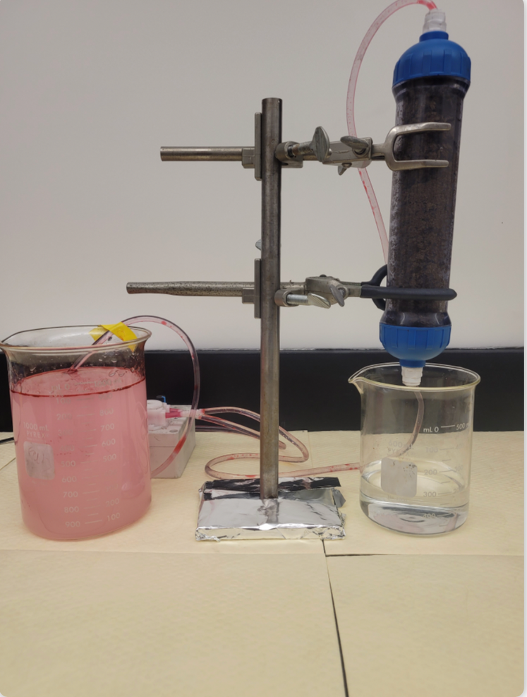
MVP
Feature Roadmap
Optimization of substrate
Size of container for scale up
Capacity for 2,000 gallons/week
Efficient Extraction Technique
Reusability of OHM Media
Notes:
Think about structuring as
- questions to be addressed
- maybe think about it as a timeline
- get numbers on wastewater

Slide 13

Competitive Analysis
Feature
Activated Carbon
OHM Media
Organo Clay
Walnut Shell
Cost
~ $3
~ $50
~ $8
~ $5
(Per 1000 L emulsion )
Reusability
up to 5x
Single use
Single use
Single use
Oil absorption compared to weight
2.4x
0.05-0.2x
0.3-0.5x
0.6-0.8x
Notes:
- talk about what we are trying to optimize it to

Slide 14


Beachhead Market
Industrial Snack Food Manufacturers:
Total Addressable Market:
Dealing with exhaustive amounts of:
Starch residues
Suspended Solids
Additives
Variable Waste Stream Processes
Variety of products in the same facility
Extreme Water-Intensive Processes
FOG Wastewater Treatment
$5.5 billion
Beachhead Market:
Tertiary Treatment of Industrial Snack Food FOG Water
~$15 Million
Notes:
Starch:
- cleaning process aftermath leaves starch residues
- can solidify if not handled efficiently
- be challenging for conventional wastewater treatment plants
- starch pretreatment becomes a critical step
Suspended Solids:
- high suspended solid yield due to process with potatoes, corn, and grains
- pretreatment = essential
Additives:
- colorants/preservatives
- add complexities to discharged water
What to work on

Slide 15
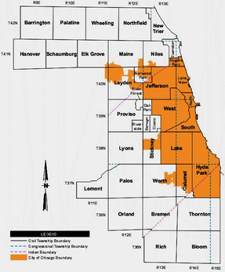




Go-To-Market Strategy and Development
Use Successful Pilot Data for Regional Marketing
Expansion + Implementation into adjacent markets regionally
Work with local municipalities to identify pilot in Beachhead Market
Scale Up MVP for
Pilot Integration
Expansion + Implementation into beachhead market regionally
Expansion into all addressable markets nationally, then globally

Slide 16
Our Mission
To offer efficient and cost-effective solutions for removing fats, oils, and grease from wastewater, promoting a cleaner global ecosystem.

